Slide 1
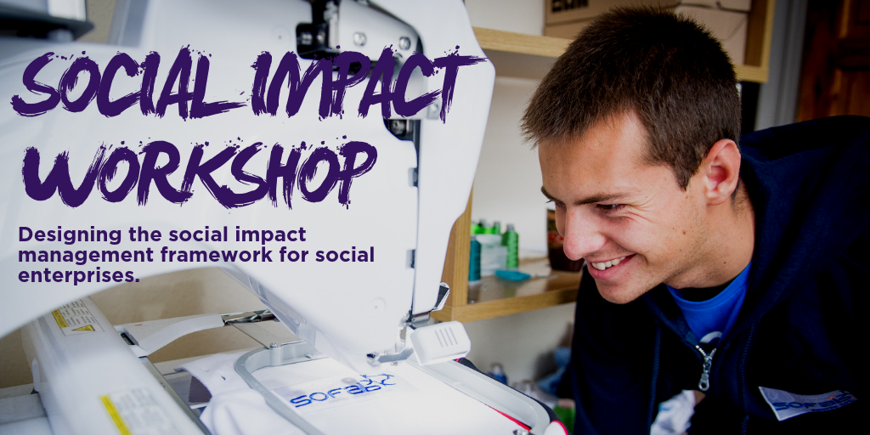
Notes:
The purpose of this session is to explore the long-term change, or social impact that you want to have, and develop a way of describing this impact through logical outcomes, measures and strategies
We will cover what social impact is and how you can measure it

Slide 2
Objectives
Have a better understanding of why you should measure and report on social impact
Develop an understanding of the Theory of Change
Describe in a single page your intended impact, outcomes, measures and strategies
Notes:
The purpose of this session is to explore the long-term change, or social impact that you want to have, and develop a way of describing this impact through logical outcomes, measures and strategies all on one page
You will leave the session with not only an understanding what social impact measurement is but with an understanding on how it can be done and how it can be applied to your own work
We hope that this simple one page exercise will help you write down the goals that you are trying to achieve, how you are going to achieve them and how you measure whether you have achieved them or not

Slide 3
What is social impact?
Definition:
“Social impact can be defined as the net effect of an activity on a community and the well-being of individuals and families.”
The term ‘social impact’ generally taken to include social, economic and environmental impact
Notes:
At a very simplistic level, ‘social impact’ is the social change that an organisation creates through its activities
Important to note that the term social impact is a catch-all phrase for social , economic and environmental impact

Slide 4
Why is measuring social impact important for you?
Internal management tool
Helps you to see how effective you are in achieving your mission
Management tool for planning and improvement
Proving your model
Communicate the value of what you do
Marketing tool - for many of you, your social impact is your USP
Inspire and motivate your staff and volunteers
Open up new funding opportunities
Different funders/social investors ‘buy’ different outcomes
Notes:
Each of you set up a social enterprise because you wanted to address a social issue.
You know you are making a difference, but measurement helps you to identify ‘what’ difference your making
So useful as an internal management tool to see if you are achieving your mission,
so helps you to identify how effective your solution is so helping you to refine and develop your processes or products
External communication tool
Helps you communicate what you do to customers and to other stakeholders
Marketing tool - for many of you, your social impact is your USP
Inspire an motivate your staff and volunteers
Broaden funding base
Different funders/social investors ‘buy’ different outcomes
Is it important to investors
For social investors/funders – Funders buy outcomes not activities
Private social Investments are increasingly driven by not only financial criteria but also the external value of social impact measurement.

Slide 5
Basic principles of impact measurement
The basic principle of impact measurement is that you can communicate:
what change you are trying to achieve,
how you are working to achieve that, and
the progress you have made so far.
A Theory of Change tells the story of how your change will unfold in the world
Notes:
A theory of change lets you map out the story of how your change will unfold in the world. Its your story of how you will make the ultimate impact.

Slide 6
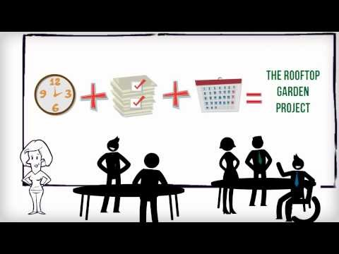
Theory of Change explained

Slide 7
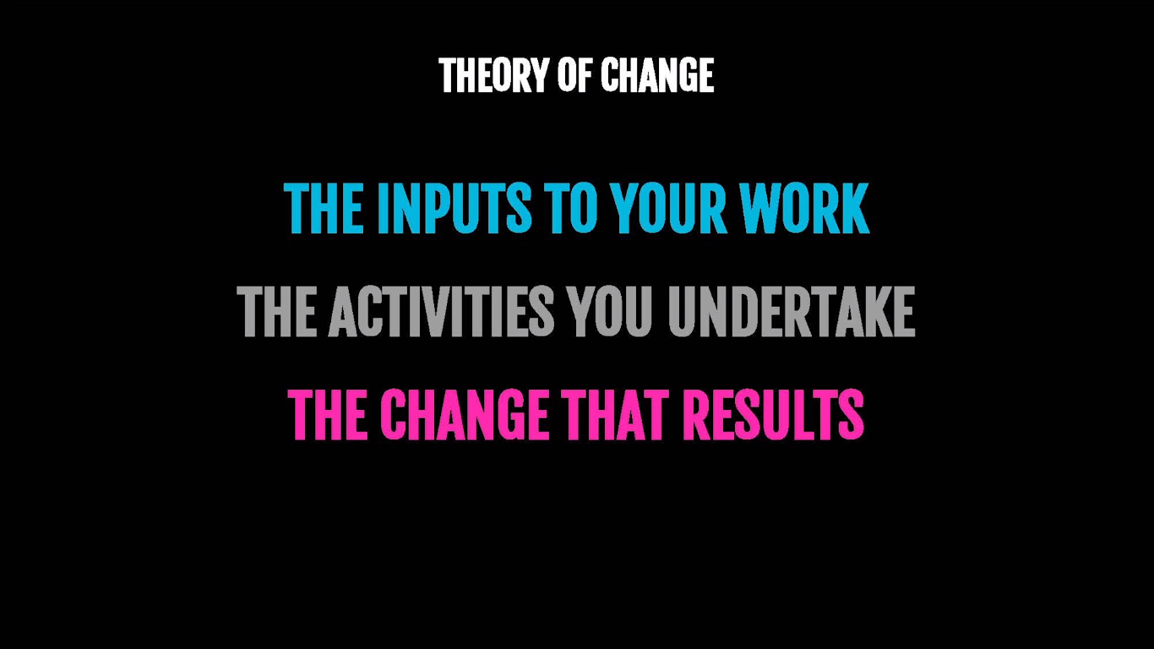
Notes:
There are a common sequence of events that make change happen
The inputs (money and equipment go into your work), then staff work on activities or projects and with that they impact people who participate in those activities and then over time they might change their behaviour or get knowledge or skills from those activities that get the results you are looking for.
Your theory of change is like a roadmap to help others understand where you are going and how you are going to get there.

Slide 8
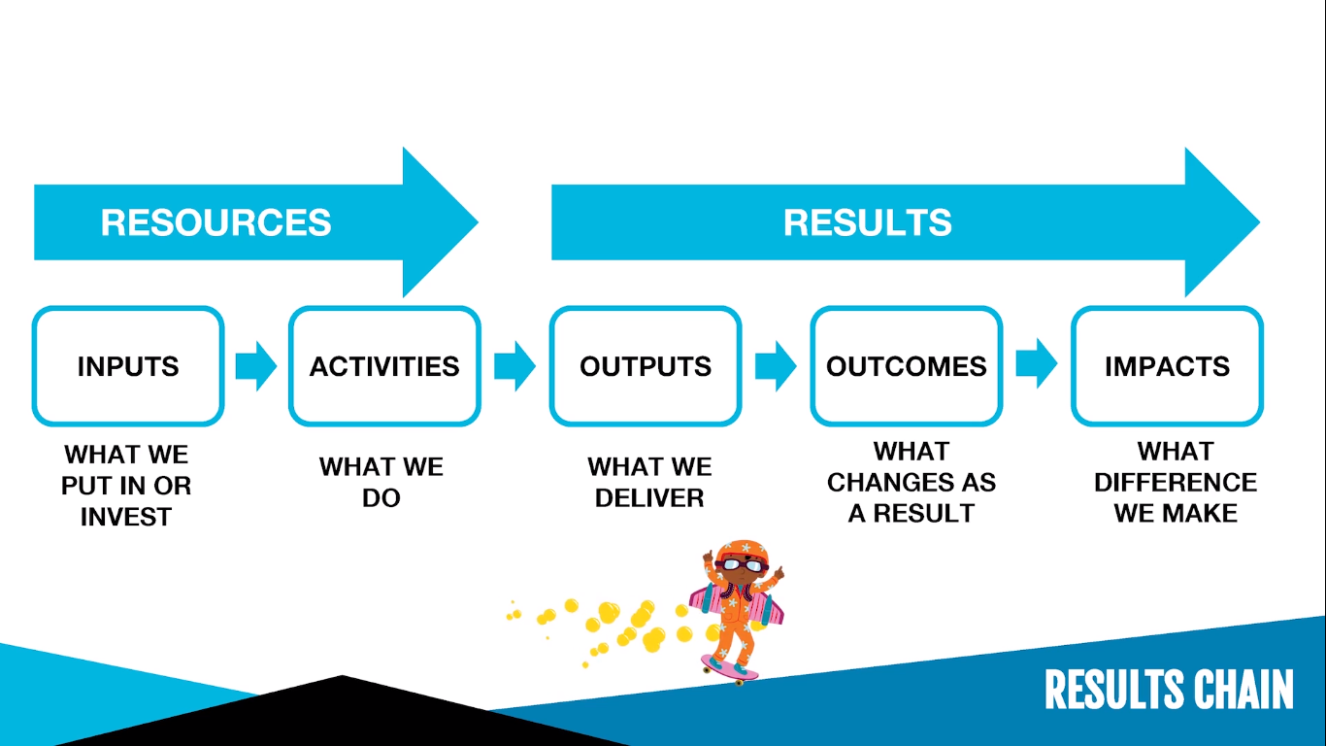
Source: Social Ent Institute
Notes:
A fuller model usually distinguishes between resources (inputs and activities) and results (outputs, outcomes and impacts)
Inputs – what you put in or invest in the programme (people, skills, network or knowledge)
Activities – things that you do e.g. activities you put on, courses delivered, etc
Outputs – what we have delivered in the activities e.g. number of people served, or number of people given a certain amount of assistance
Outcomes – the changes in people as a result of the work with you
Impact – the difference that you make in peoples lives or the long-term outcome of your work
The long-term impact might take years if not more to measure change and that’s why we measure outputs and outcomes to help show that we are moving towards that ultimate impact, even if we cant measure it right away.
A chain like this provides a really great basis for planning and measurement

Slide 9
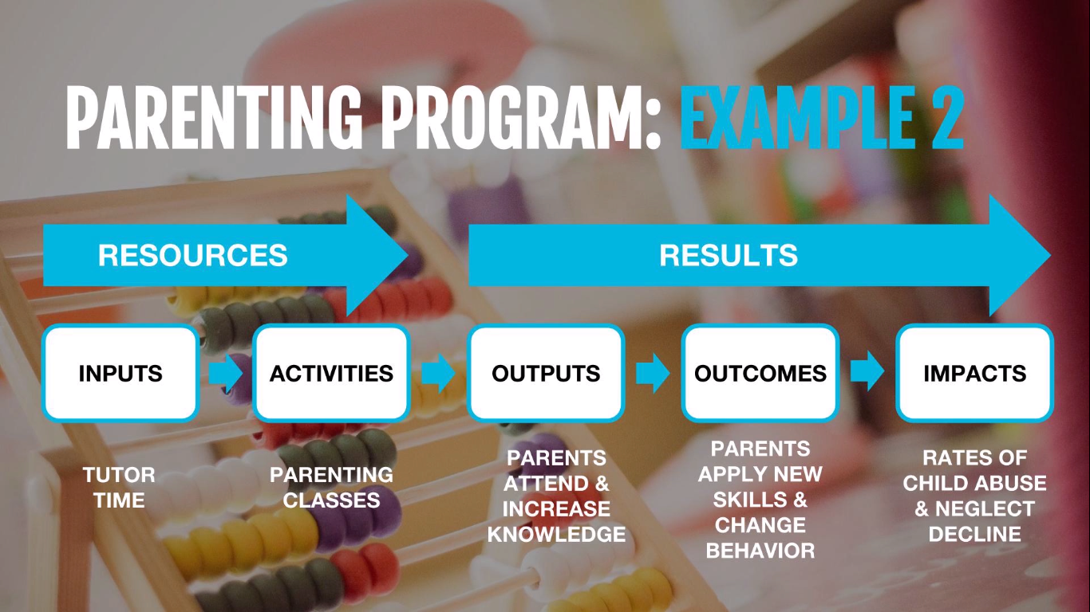
Source: Social Ent Institute
Notes:
Tutor time goes into the work. The activities are parenting classes which parents attend. If things work out they get results. Results can happen immediately or over a long period of time.
The outputs, the things that immediately happen from the activities are when parents attend classes and increase their knowledge about parenting. Medium term outcomes, things that take a little longer to happen would be parents applying these now skills to their babies and seeing a change in their behaviour. Finally, over a long period of time we want to see long term impact in reducing the rates of child abuse or a declining rate of neglect.
Key message: from a measurement point of view we are usually more interested in putting some numbers to the results of the programme rather than quantifying the resources. It’s the results part that you want to include in your social impact goals.
It’s a form of logic model i.e. a graphic that represents the way your work brings about change

Slide 10
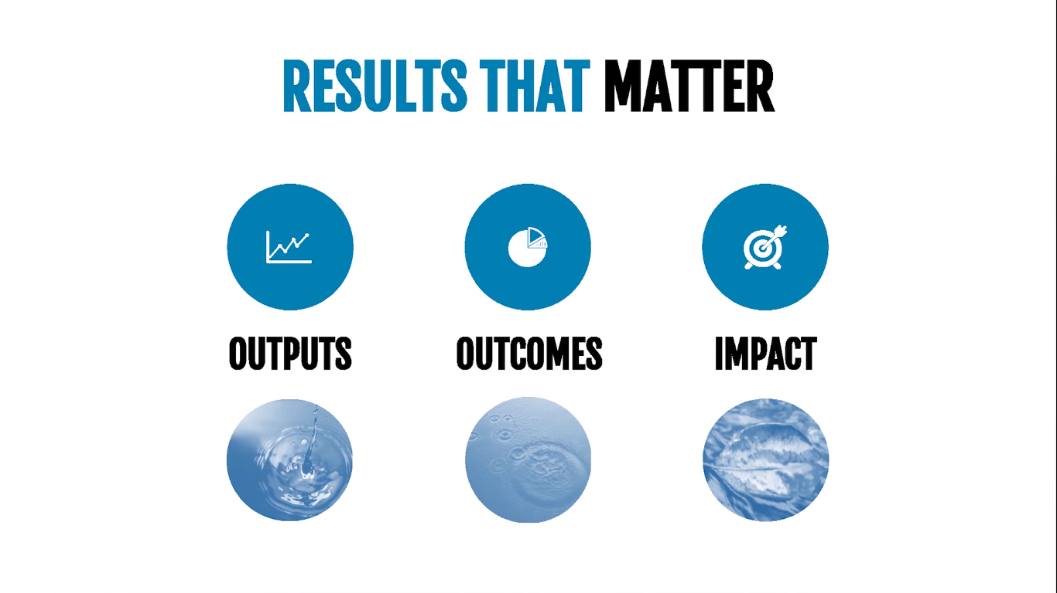
Notes:
Example: think about the act of throwing a pebble in a pond
Output – when the pebble splashes the water those are the outputs of your programme. That’s the things that immediately happen as a result of your action
Outcome – Then the ripples that come out of that splash are the outcomes i.e. the short to medium term impact that your programme has made on people
Impact – Then if you think about the long term impact there could be a leaf floating downstream that gets affected by the ripples. It moves and is carried by the effect of your programme
So if you think about it in terms of that analogy of the ripple in the pond what you are really looking to do is make an impact on the leaf that is floating far down stream. It might take years to happen but ultimately you want to make that change, not necessary just what happens when you throw the pebble into the river
The final destination of the leaf (the service user) is unpredictable and can be influenced by many things including the power of your throw (the programme or service)

Slide 11
Building Your Logic Model
Notes:
We talked about theory of change which is a theory or guess you have about what change you are going to make in the world
Now we will look at logic models. We will help you present the impact that you want to make in the world, the change in the position of the leaf, on a one page visual model, a logic model (a visual representation that’s logical and makes sense showing clearly the impact you will make step by step)

Slide 12
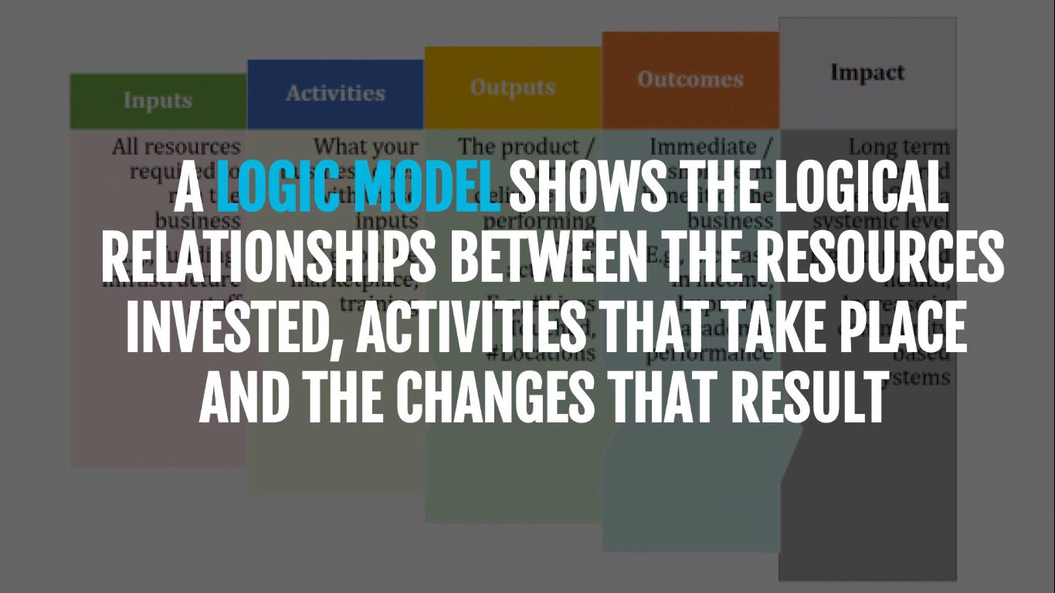
Source: Social Ent Institute
Notes:
Different types of diagrams can be used to represent your ToC. These are referred to as logic models – they show the logical relationship between inputs activities and results
Logic models provide a helpful framework to explain the impact that you are trying to make in the world and the theory that lies behind it

Slide 13
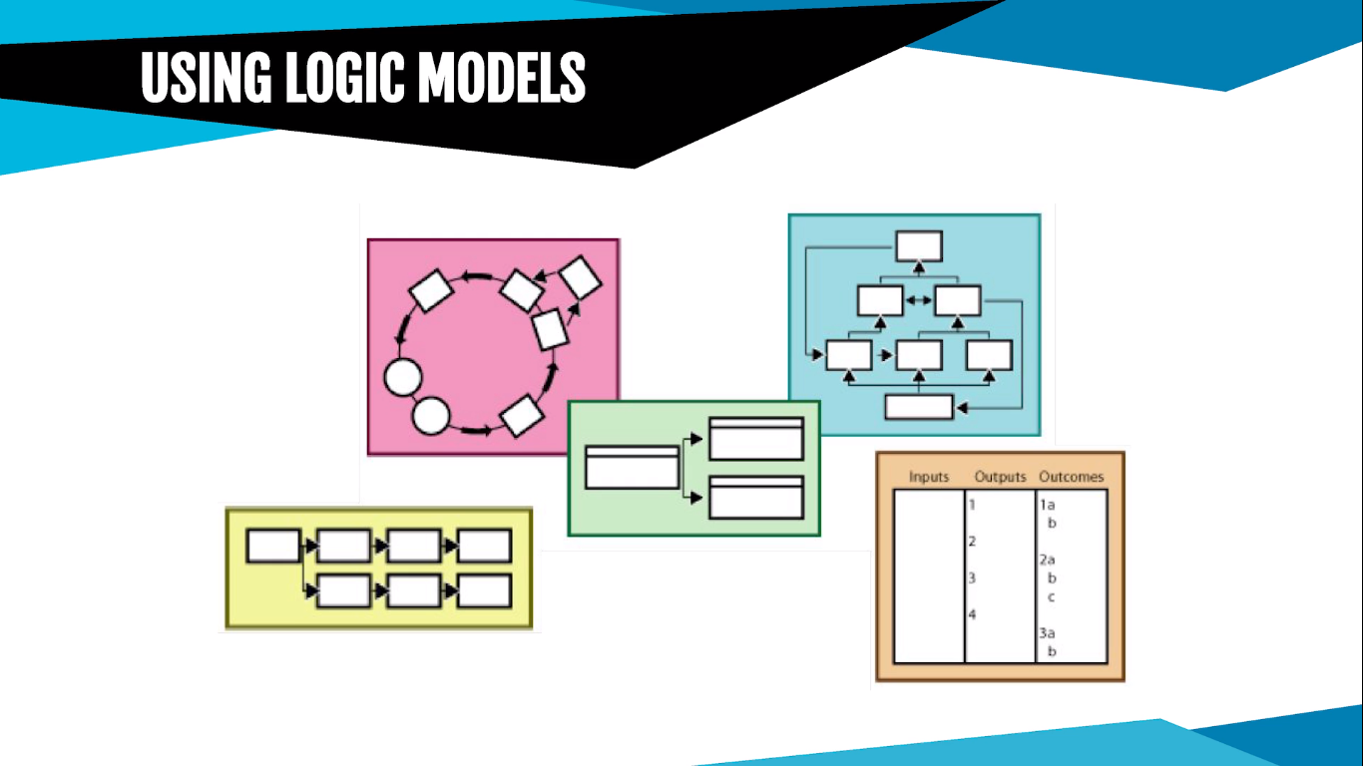
Source: Social Ent Institute
Notes:
Logic models are like a roadmap that outline the steps you will take to achieve your goal (financial or social) and how you will know you are moving in the right direction towards achieving the change
Some logic models show a liner progression from input to impact and there are many types of logic models that you can use to visually represent change – log frames, ToC models, results chains
Think about how you could conceptualise the change effort for your social enterprise in a way that makes sense to you. You can use diagrams, pictures and flowcharts as you feel appropriate.

Slide 14
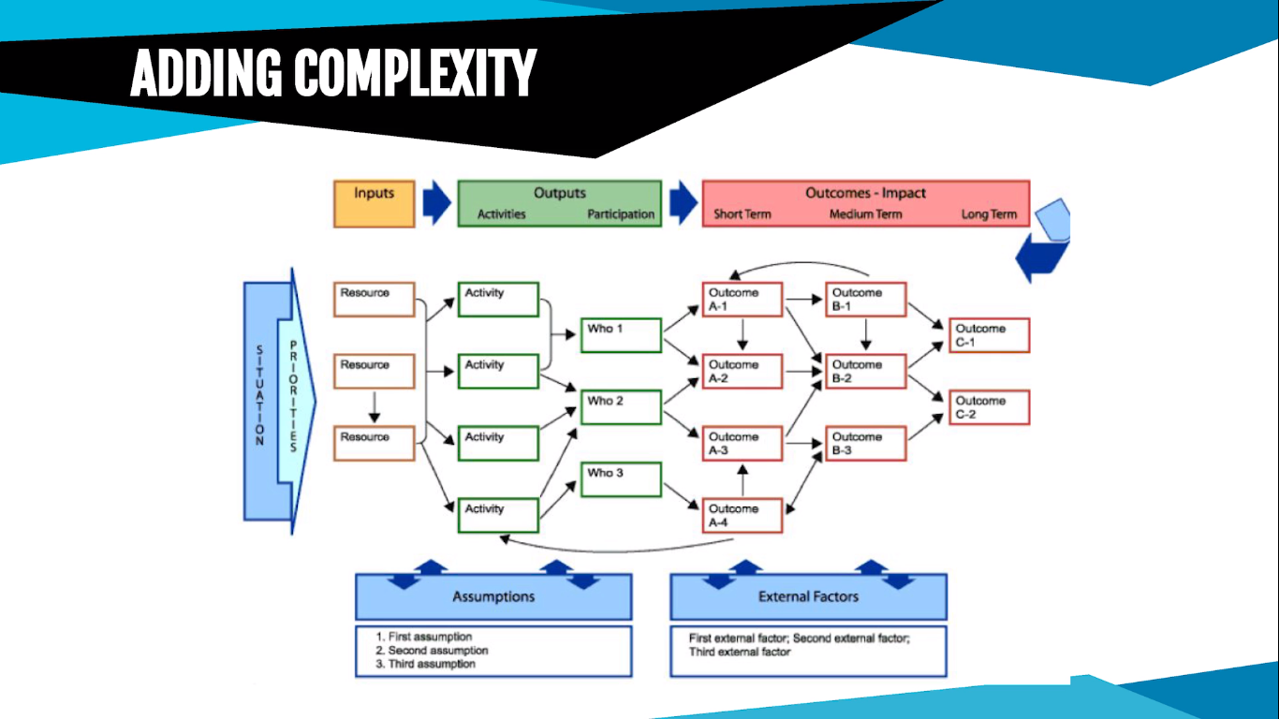
Source: Social Ent Institute
Notes:
You can add a great deal of complexity such as in the example here. It’s a more advanced logic model and provides a picture of the root cause of the situation that you are tackling, how change will be created including any pre conditions. It also shows the key dependences and the role of other variables in bringing about change such as the role of other organisations. This one is very complex and could be time consuming and confusing.
Logic models can be as simple or as complicated as you need to but for most social enterprises usually simpler is better

Slide 15
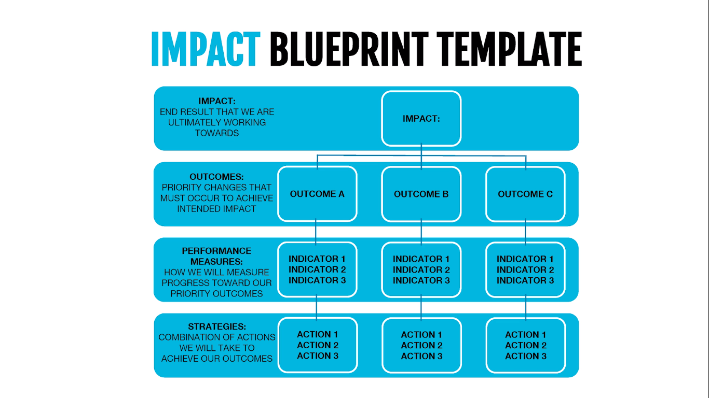
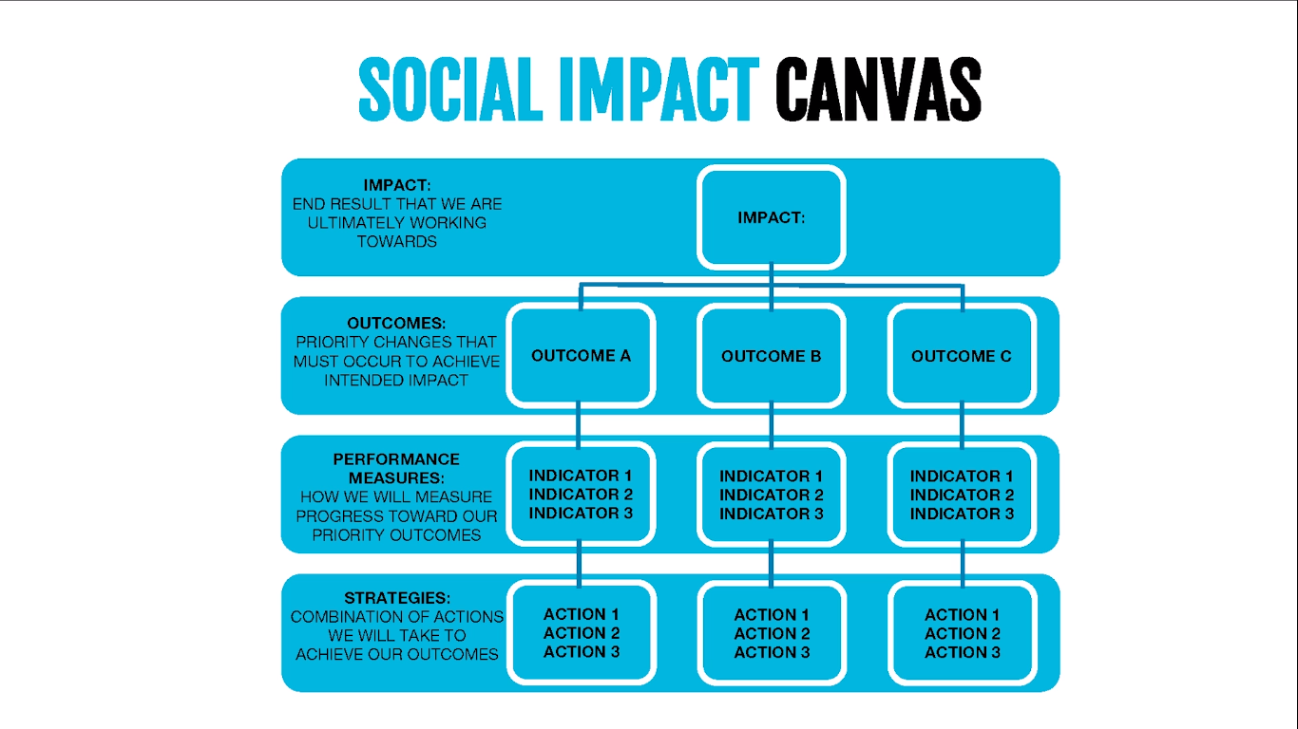
Source: Social Ent Institute
Notes:
Simplicity is key when looking at impact so we recommend this really straightforward form of a logic model – the social impact canvas

Slide 16
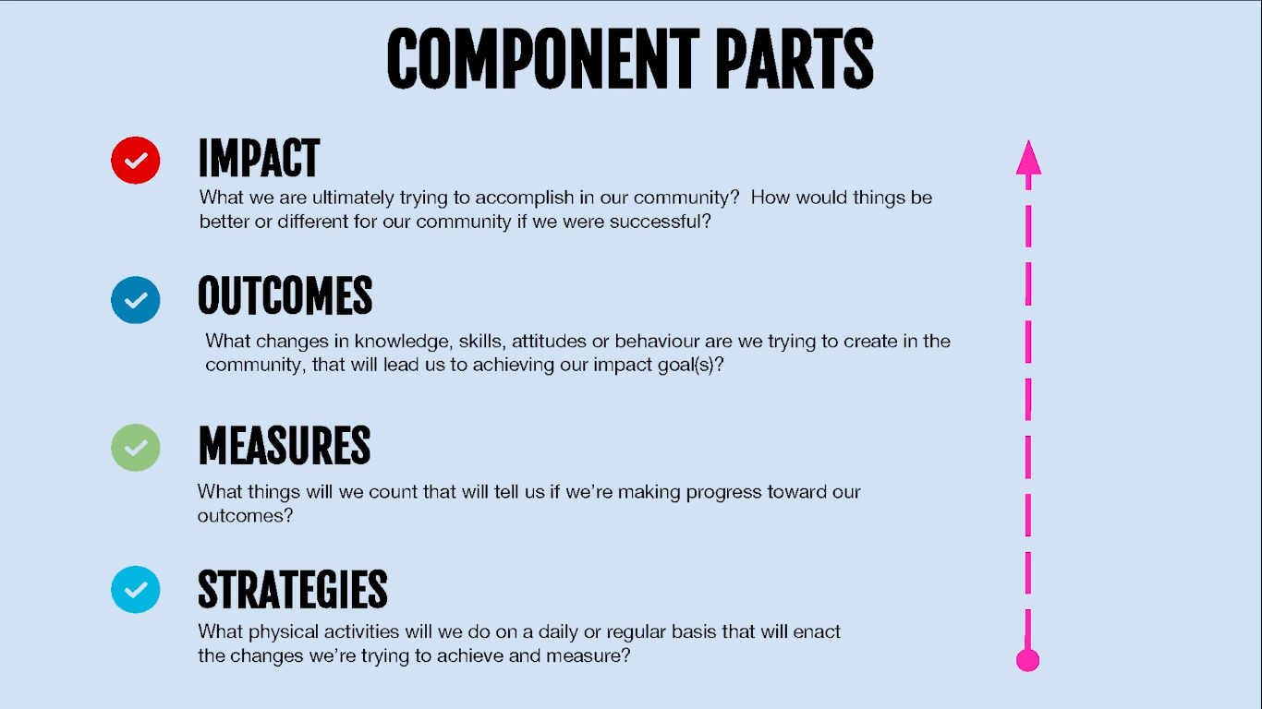
Source: Social Ent Institute
Notes:
Breaking down the social impact canvas.
At the bottom we have strategies which are like the activities we take to make the impact
Next is measures which - these are the things you can measure about your activities to help indicate whether you are successful or not. You could have measures relating to outputs and also outcome related measures.
Next up are the outcomes – these are the medium to long term impacts that we want to make and the impact is the final or long term change that you want to bring about

Slide 17
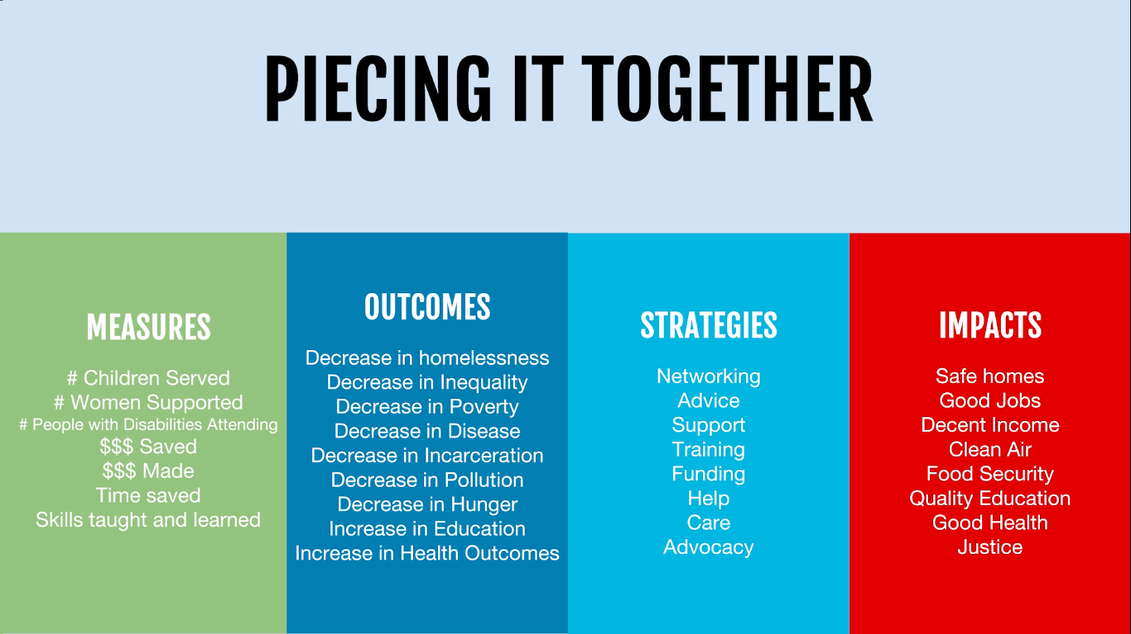
Source: Social Ent Institute
Notes:
In the mission statement we were talking about what we do and who we effect. Bun now in the social impact canvas we are looking at impact and how we are going to measure it i.e. what comes from what we do and who we effect that will lead to long term impact

Slide 18
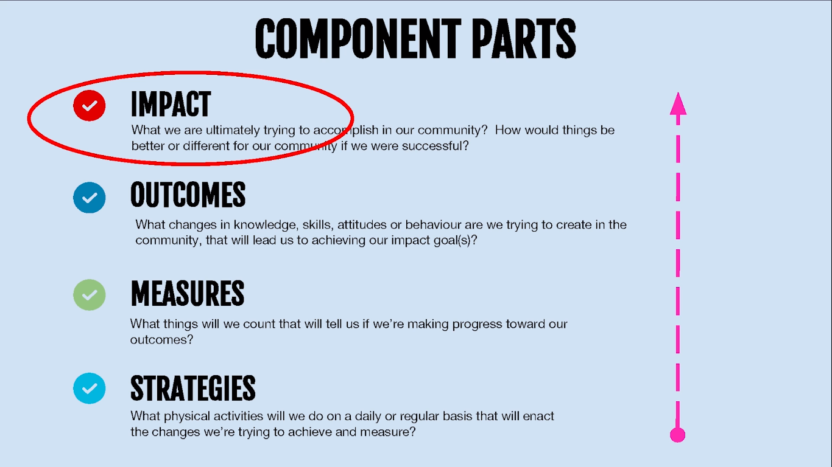
Source: Social Ent Institute
Notes:
The impact is the ultimate change we want to make in the community. This can also be called your vision statement

Slide 19
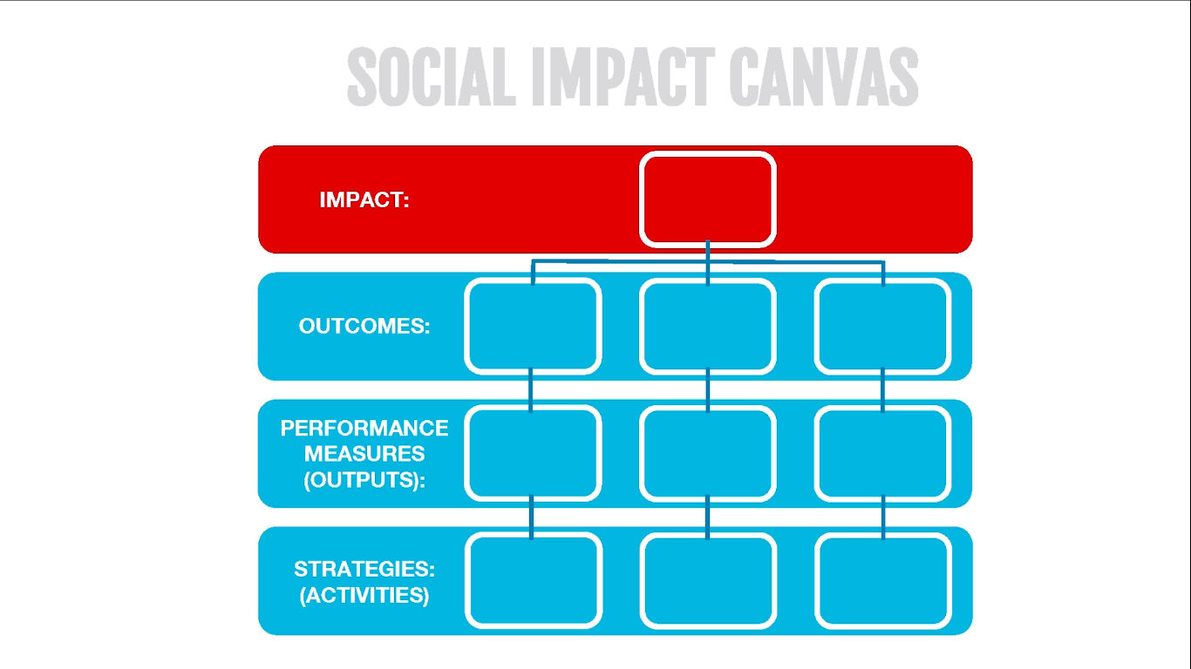
Source: Social Ent Institute
Notes:
Here it is at the top of the social impact canvas.
It’s the long term impact that will be achieved if your efforts are successful – its how you are going to change the world!!!
Keep this statement aspirational. You want to use it to inspire people. The statement should be one sentence to keep it easy to understand. Ask people around you to give you feedback and see if they understand what you are trying to get at.
In worksheet #2 take a moment to fill in the top section of this diagram

Slide 20
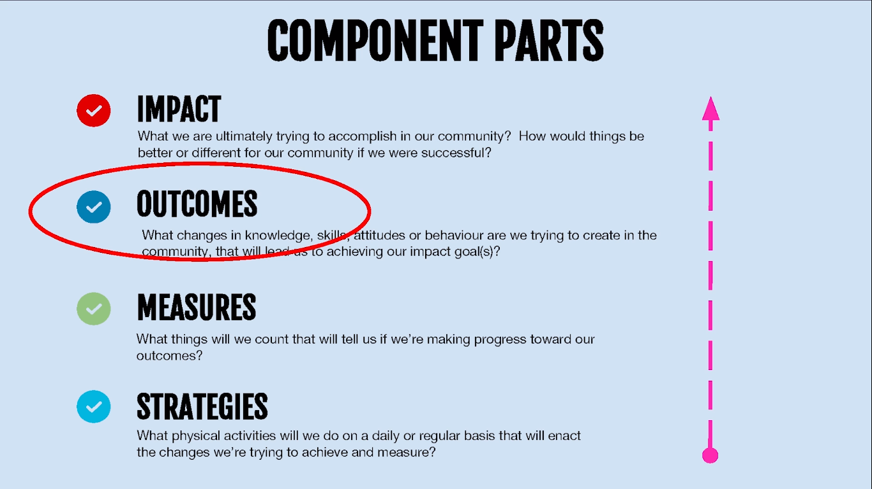
Source: Social Ent Institute
Notes:
In order to demonstrate you are working towards your impact you have to measure outcomes. They should be the central focus of your measurement efforts
Outcomes describe the difference your organisation makes through the things it does or provides
It’s the changes of knowledge, skills, behaviours, attitudes, and activities of the people or environment that you are trying to impact.
They are the results that you can measure in the medium term – usually between 1-5 years

Slide 21
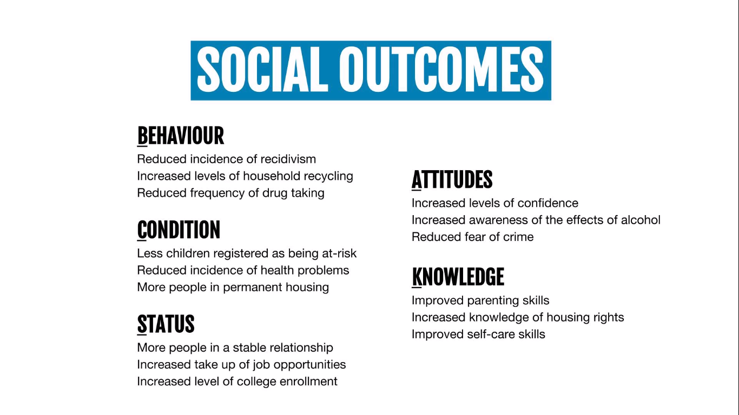
Source: Social Ent Institute
Notes:
Outcomes are measurable in terms of increases, decreases, improvements, etc.
They can be broken down into different types
Behavioural change e.g. reduced incidences of re-offending, reducing the frequency of taking drugs. These can be behaviours that you can measure
Attitudes can also change e.g. increased confidence, reduced fear of crime, are people more aware of the effect that alcohol has on their lives
Conditions – are peoples lifestyles and conditions changing e.g. perhaps there health problems are less because they are exercising more, or perhaps they are in longer term housing because they have better income
Knowledge such as an increase in knowledge in what they can do when problems arise e.g. improved knowledge of a topic like housing rights
And finally, a change in status – has someone moved from an abusive relationship into stable relationship, have they gone from jobless to having a job, have they went from non graduate to a graduate

Slide 22
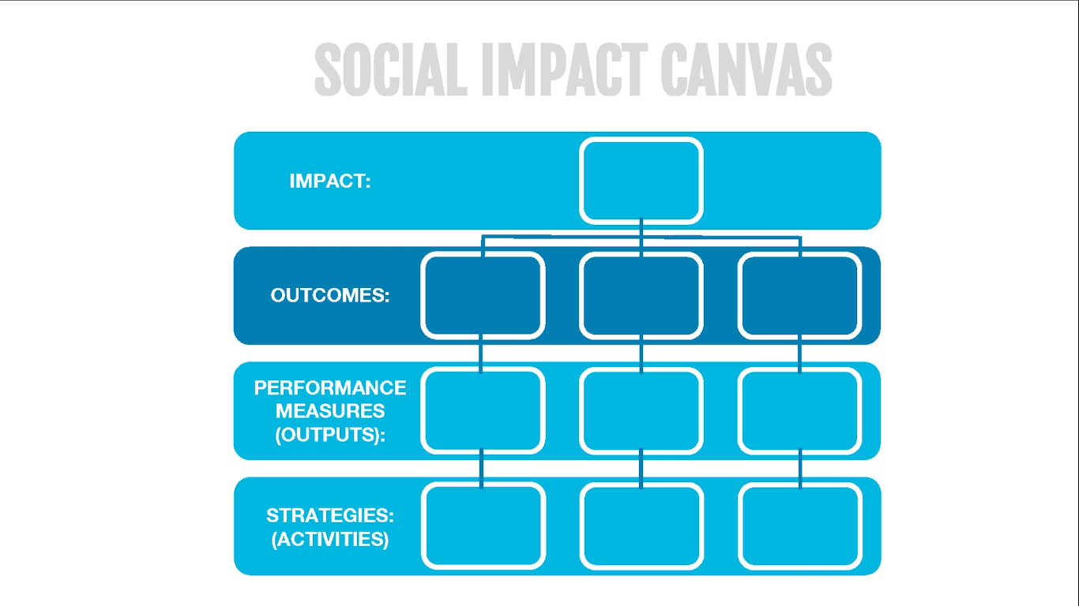
Source: Social Ent Institute
Notes:
Outcomes are second from the top on the social impact canvas. Think of listing them as stats – things you can measure like a percentage or a number change (homelessness, inequality, poverty, disease, etc)
Start with a small number of outcomes and no more than five. The outcomes builder will help you outline what outcomes you want to measure – see activity

Slide 23
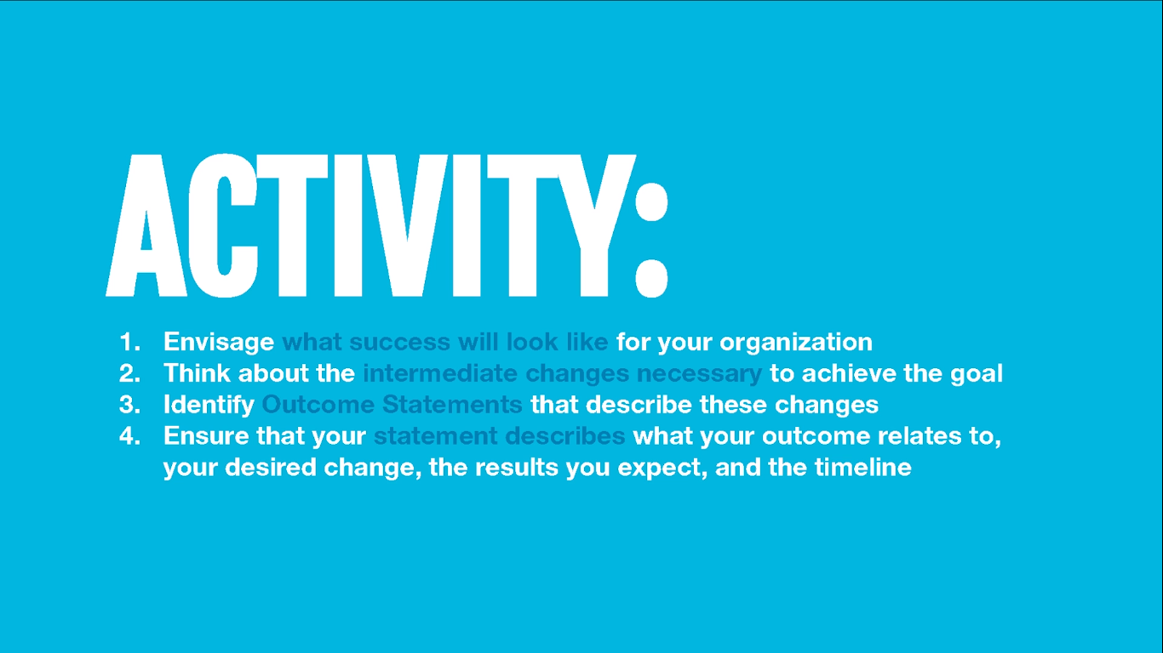
Source: Social Ent Institute

Slide 24
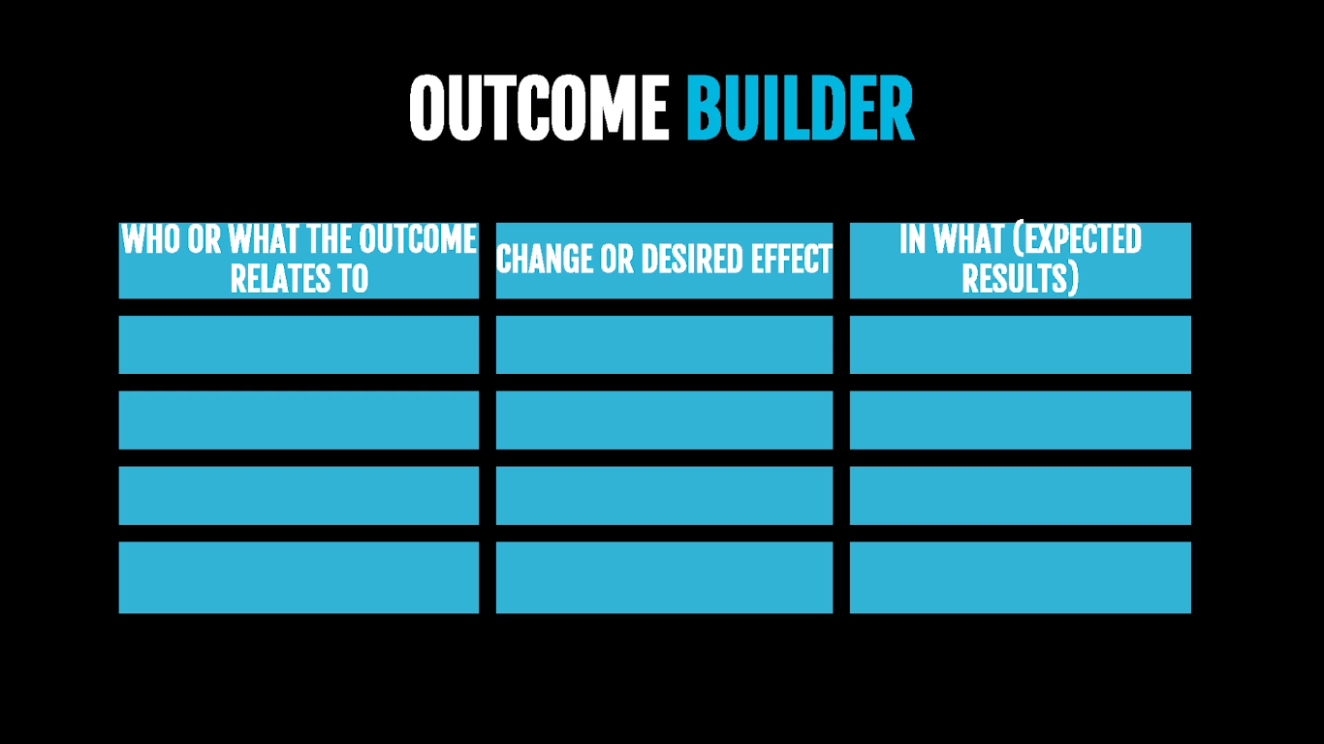
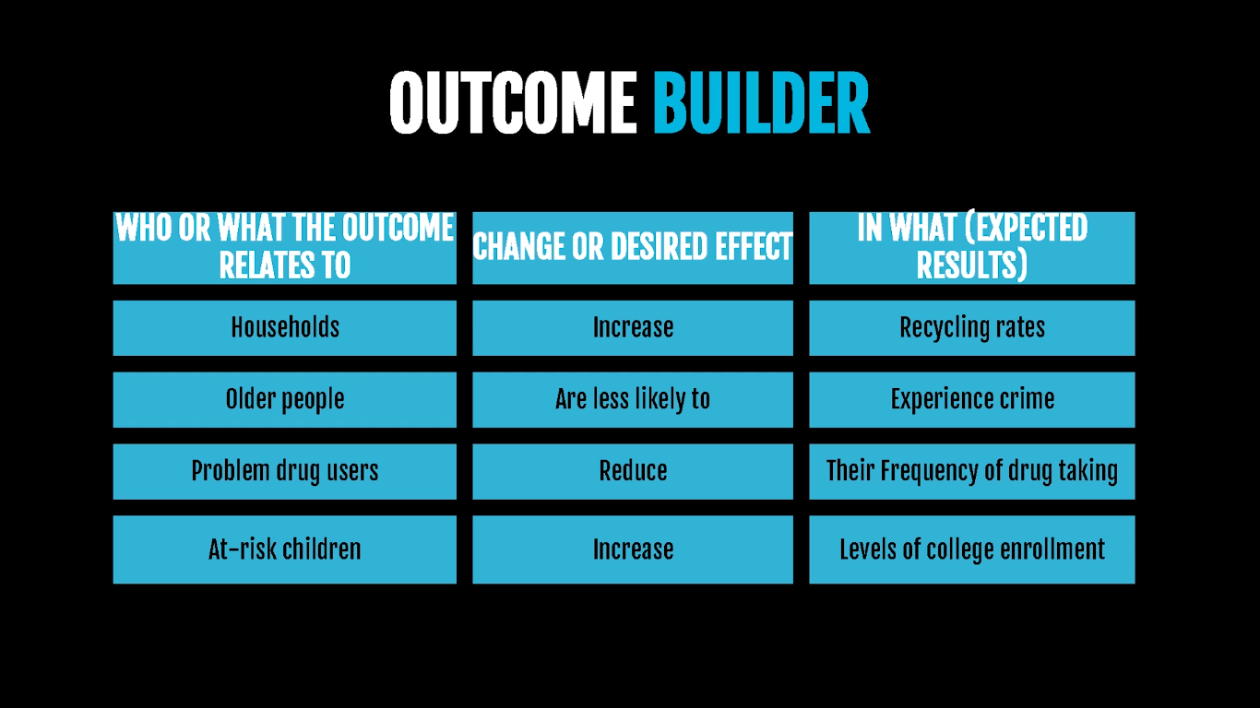
Source: Social Ent Institute
Notes:
On the left you can look at who is effected by the problem, then look at the change or desired effect that you want to have on them (e.g. increasing their skills), then on the far column on the right we want to see what their results are
Here are a few examples. Perhaps you want older people to be less likely to experience crime, perhaps you want at risk children to increase levels of college enrolment.
Take a look at the examples and build your own outcomes. Who is affected, what change are you going to have on them and what's the ultimate result that you would like to see in their lives

Slide 25
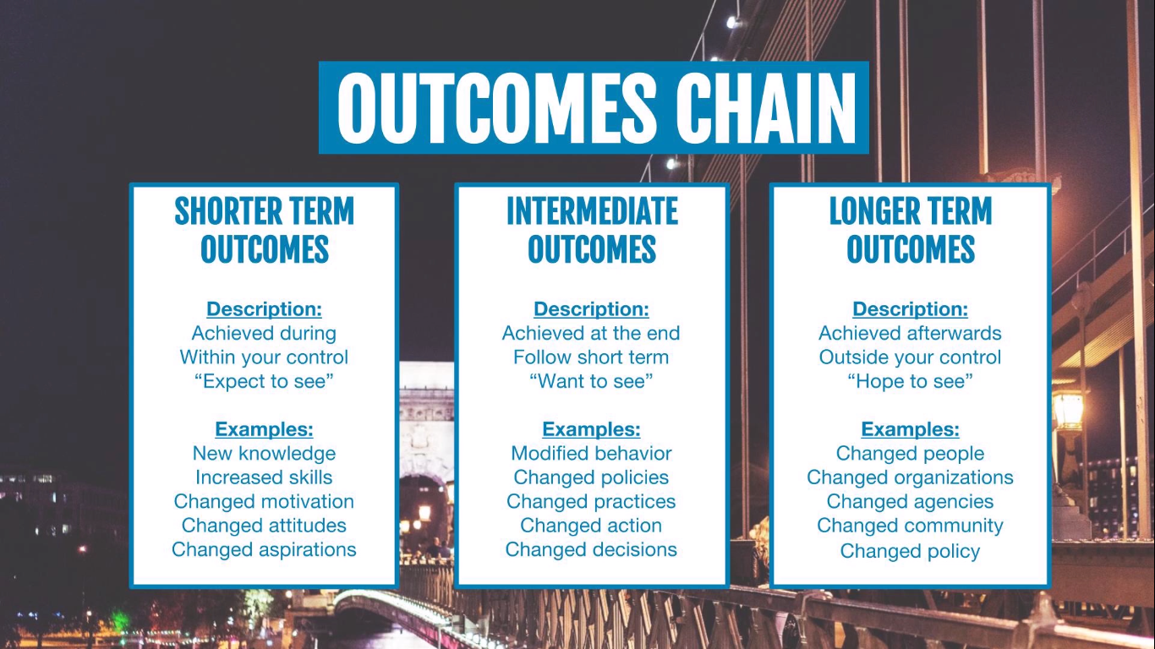
Source: Social Ent Institute
Notes:
Some outcomes may not come for a long time plus you may not be the only ones responsible for bringing about these outcomes. You might need to therefore focus on shorter term or intermediate outcomes.
Here is a typical chain of outcomes.
We see some short term outcomes that arise through any project or programme. These are really achieved through the life of the programme and are within your control. These are the things that you really expect to see. Could be new knowledge, increased skills, etc
We then have your intermediate outcomes. That’s outcomes that are achieved at the end of the programme and follow the short term goals. These are things that we really want to see. This could be a change in behaviour, change in polices, etc
We then have the longer term outcomes or the ultimate impact of your work. These are often achieved sometime after the programme itself and are often outside your control. They are things that we hope to see. These can be the ultimate changes over time in the people, the organisations, agencies, etc. These are the big goals that we are striving for that align with the long term mission of your organisation. They are difficult and take a lot of work and happen over time and all you can do is do those dady to day short term activities that you know will lead to those longer term outcomes
The further you get from the end of the programme the more challenging it is to measure change accurately and gauge contribution to this change. That’s why so many people measure outputs - #people attending your event, seen your video, etc. What’s harder to measure is the longer term change in the BACKS.

Slide 26

Source: Social Ent Institute
Notes:
Take a look at the social impact canvas and fill out the second section from the top using the medium to longer term outcomes that you want to achieve (1-5 years)

Slide 27
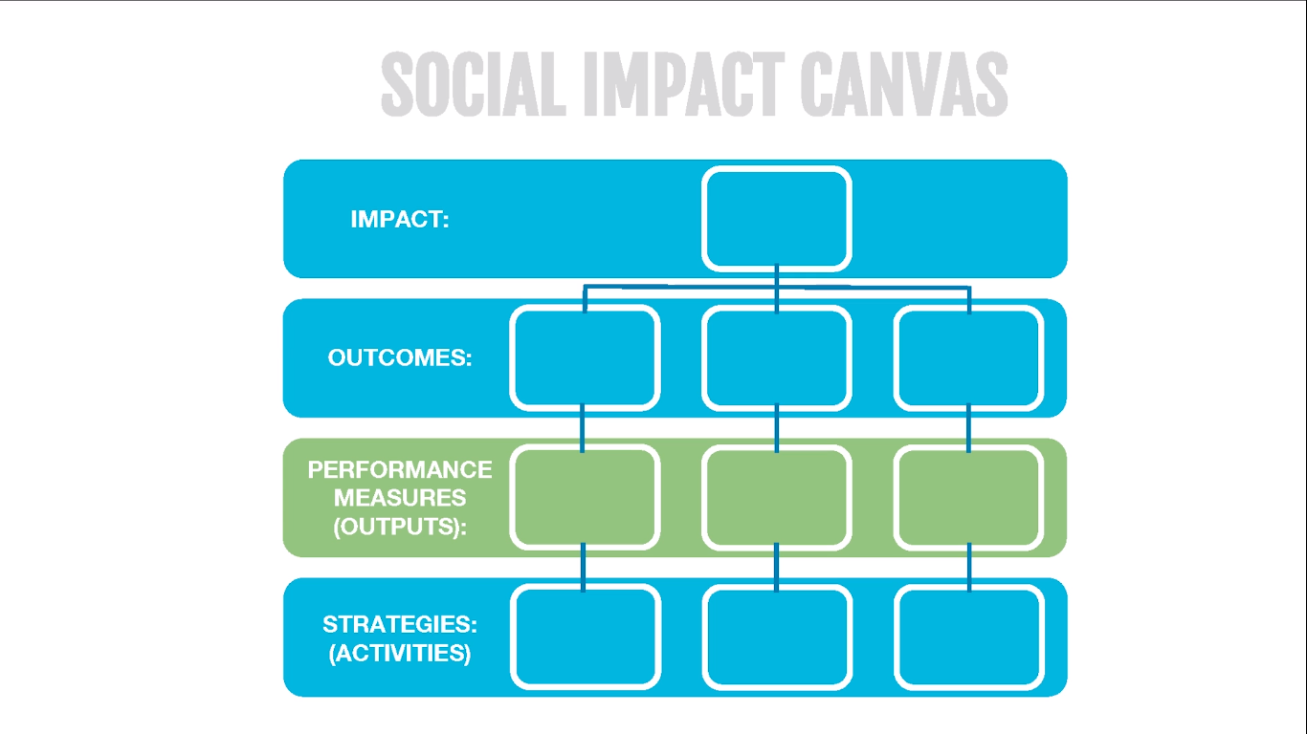
Source: Social Ent Institute

Slide 28
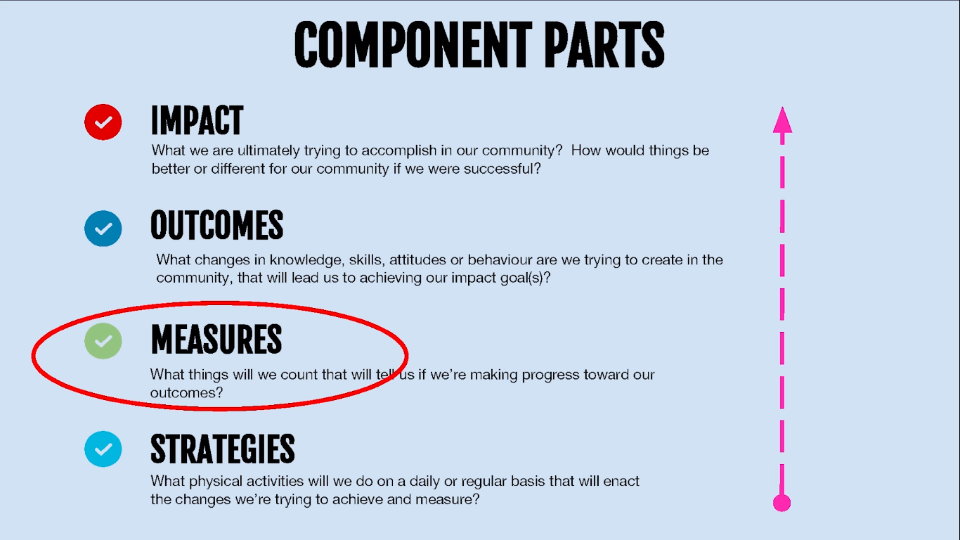
Source: Social Ent Institute
Notes:
Performance measures are tangible signs that your social enterprise is working towards its impact (~people attending an event, a class, etc)

Slide 29
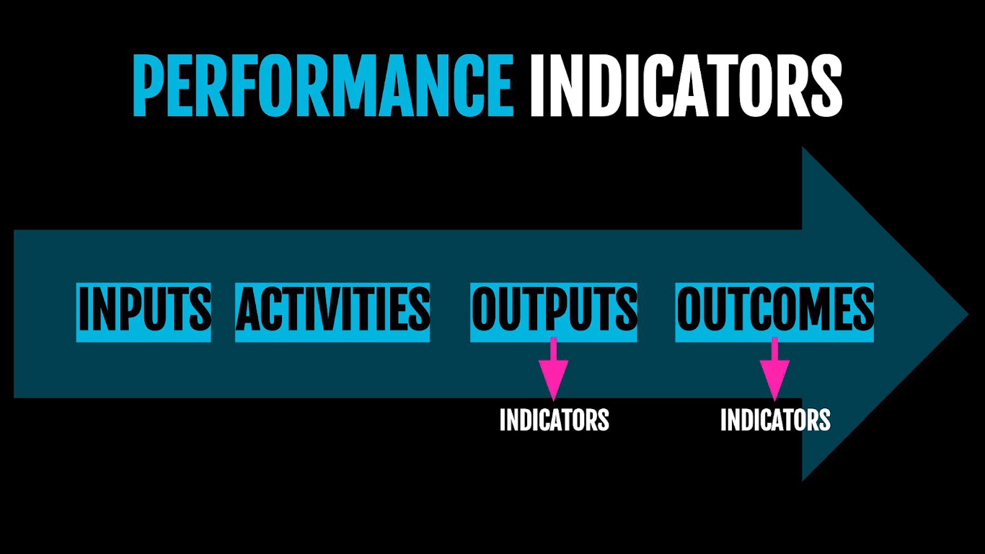
Source: Social Ent Institute
Notes:
There will be results that you measure for your outputs and your outcomes. Its likely that other groups have already started measuring these outputs and outcomes. If you can see what they measure you might help find what to measure where the kinks have already been worked out. They have already proven that the things that they are measuring lead to the long term success you are striving for. For example an organisation that’s been working on poverty reduction for years will know what activities need to happen and what things they need to measure to lead to that long term impact of reducing poverty. They will have done the ground work in working out what things you should measure that will point to the long term impact that you are trying to achieve.

Slide 30
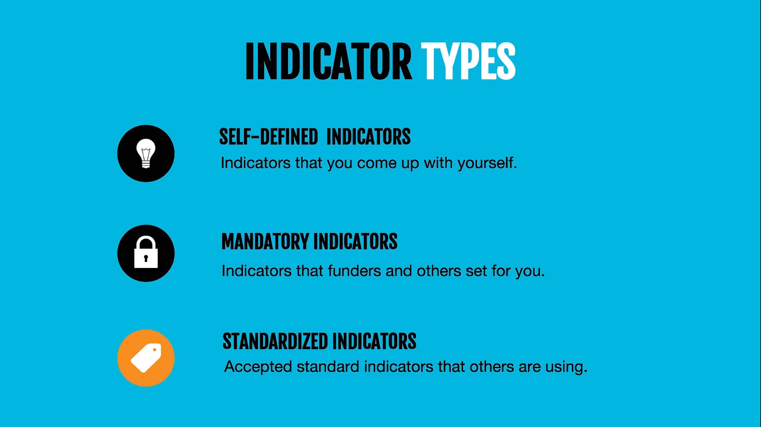
Source: Social Ent Institute
Notes:
There are three main types of indicators
Self defined indicators allow you to create and produce indicators that reflect very closely the work you do and the results you achieve. The best indicators are those that are highly context specific
Mandatory – set by funders as a condition of your grant or loan. Often non negotiable and must be used for performance monitoring and reporting.
Standardised – can be selected from lists or directories to make the job of reporting much more straight forward. This could include official government indicators used to show important changes in the situations of people or the issues that you are tackling. These indicators can produce a good starting point, source of inspiration or a ready made solution
But its important to find indicators that are a really good fit for your org and for the change that you are working towards.

Slide 31
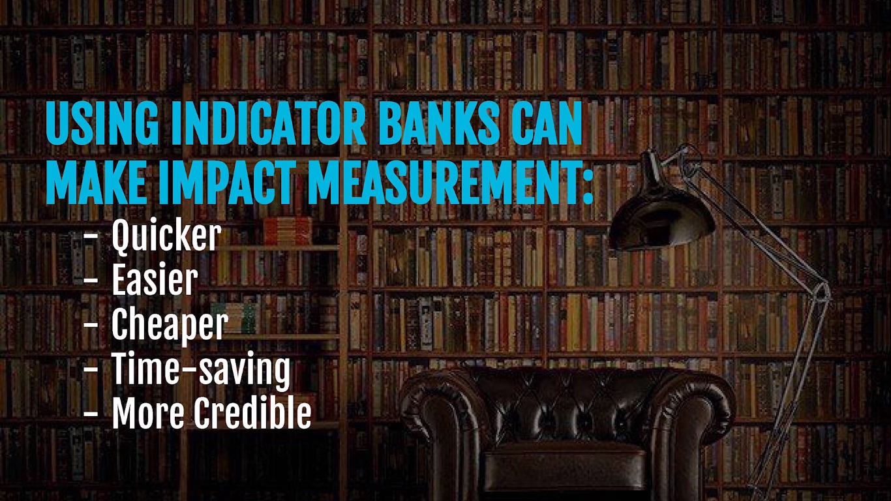
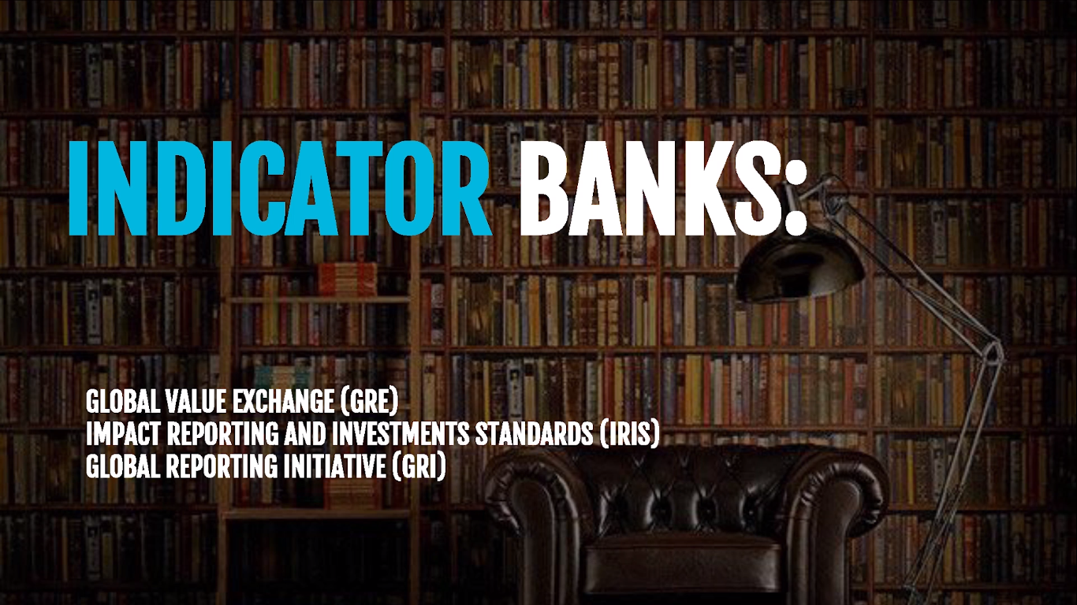
Source: Social Ent Institute
Notes:
Indicator banks can be a good source of indicators.
There are three internationally recognised indicator banks….
GVE - Includes an aggregation of a number of other indicator banks
GRI - Used manly by large corporations to measure economic and environmental as well as social impact
Finding tried and tested outcome measures can save a lot of legwork in testing your own programmes over time to see if they are successful. Using these banks will point you in the right direction for choosing what you should measure in your activities.

Slide 32
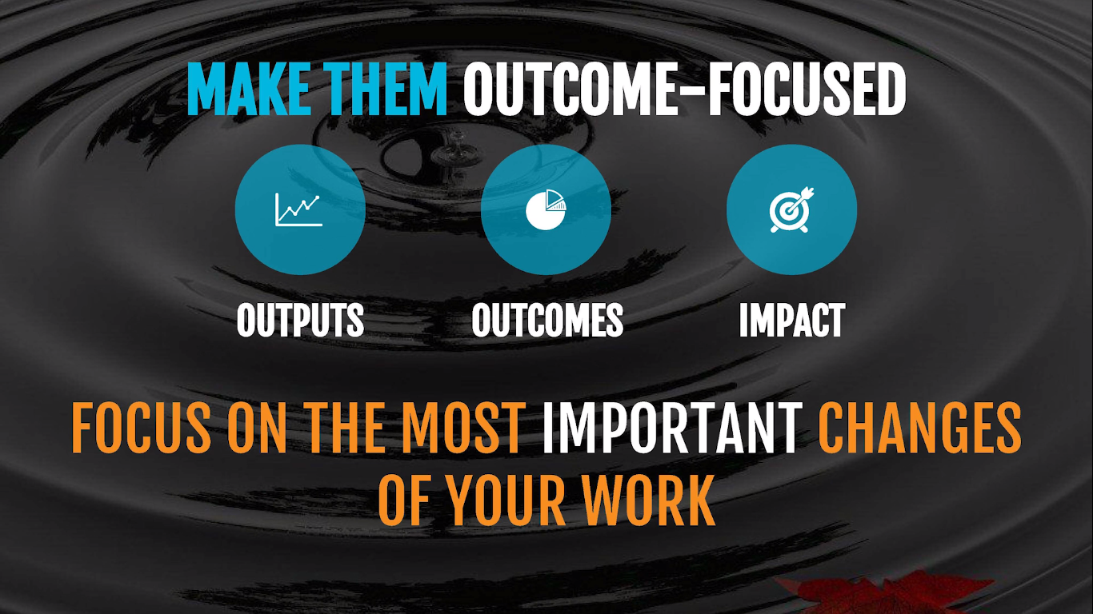
Source: Social Ent Institute
Notes:
In order for your outcome measurement efforts to have meaning your indicators should have an outcome focus.
Example: throwing a pebble in a pond
Output – splash when pebble hits the water
Outcome – expanding circles of ripples that represent the ongoing change in conditions in the water
Impact – the changing position of the leaf that has been effected by the ripples
The final destination of the leaf (the service user) is unpredictable and can be influenced by many things including the power of your throw (the programme or service)
The point is that the performance indicators should focus on the most important changes of your work. This is not the splash or the things that can be immediately observed but rather the longer-term ripples of outcomes that occur as a result.
Indicators should be highly specific to the types of changes that you can observe and should give you enough information to be able to show progress as well as change.

Slide 33
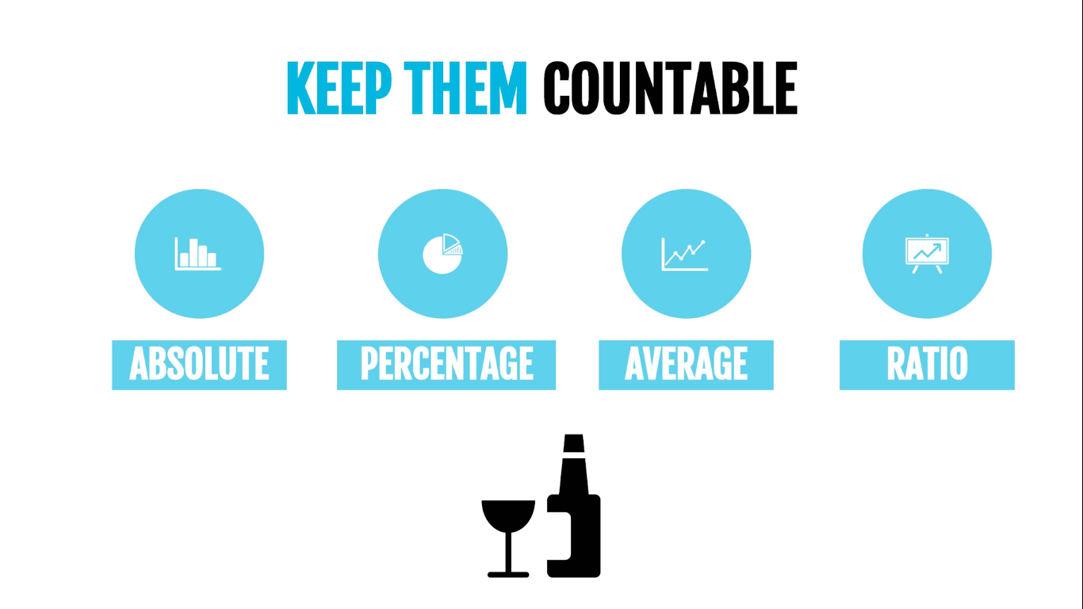
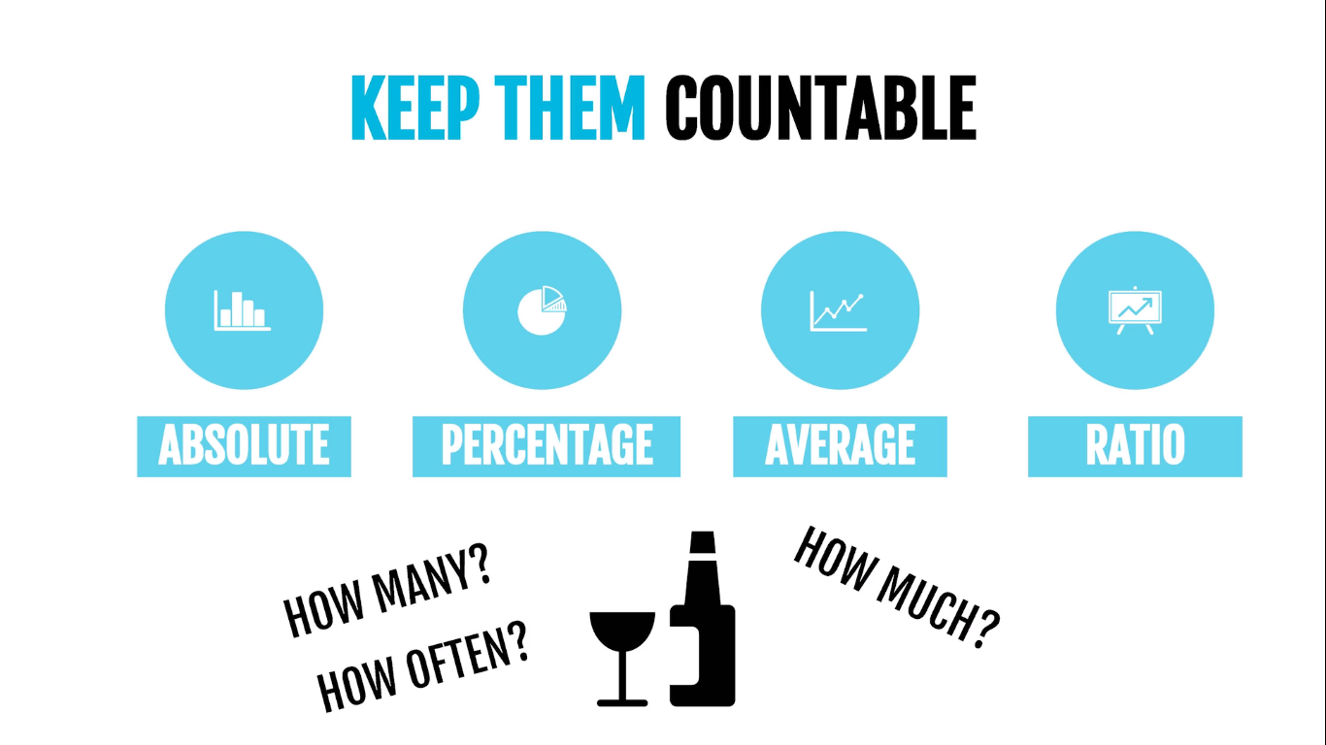
Source: Social Ent Institute
Notes:
Where possible you should focus on quantative performance measures that are countable
The measures may be an absolute level of change, a percentage, an average or a ratio
Try to chose measures that are specific to solving your problems (preferably if they can be found in indicator banks), that are measurable and you can measure if they happen or not, they are attainable i.e. things that you can help your clients do, and that they are realistic and can be done in a reasonable amount of time.
For example the number of people that reduce alcohol dependency move into independent accommodation, or report increased confidence as a result of your work. Such indicators answer questions about the quantity of outcome achieved i.e. how many, how much and how often.
It doesn’t have to be perfect at this point. Just take a stab at writing down the things you can measure for your social enterprise to determine its success.

Slide 34
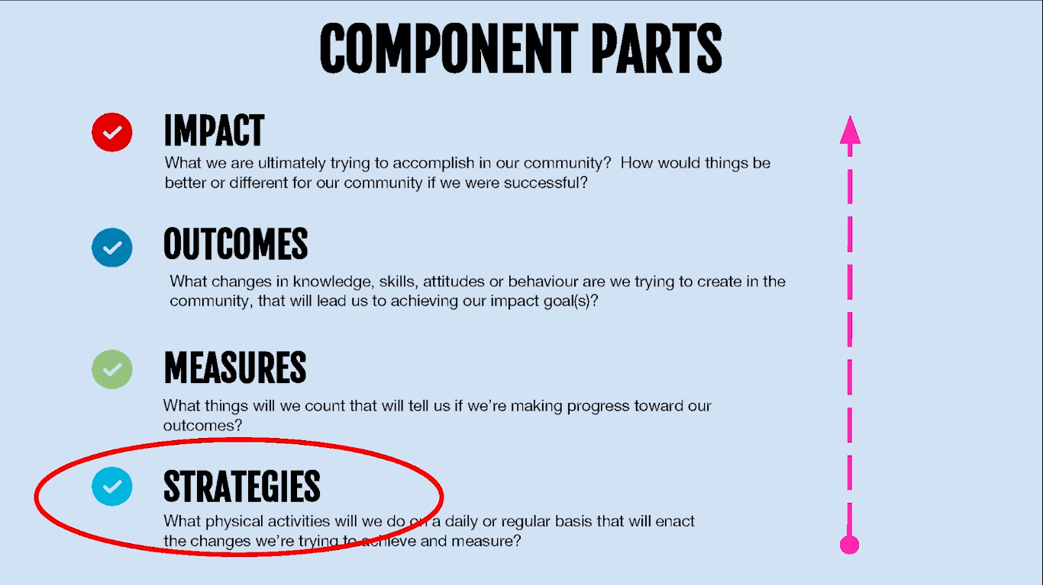
Source: Social Ent Institute
Notes:
Finally, lets look at the strategies. The strategies are mix of actions or activities you do on a daily or regular basis. They are designed to strengthen your performance and improve your outcomes. Ask yourself what would it take to succeed. Think about how you can strengthen or realign your strategies to ensure that you achieve better results.

Slide 35
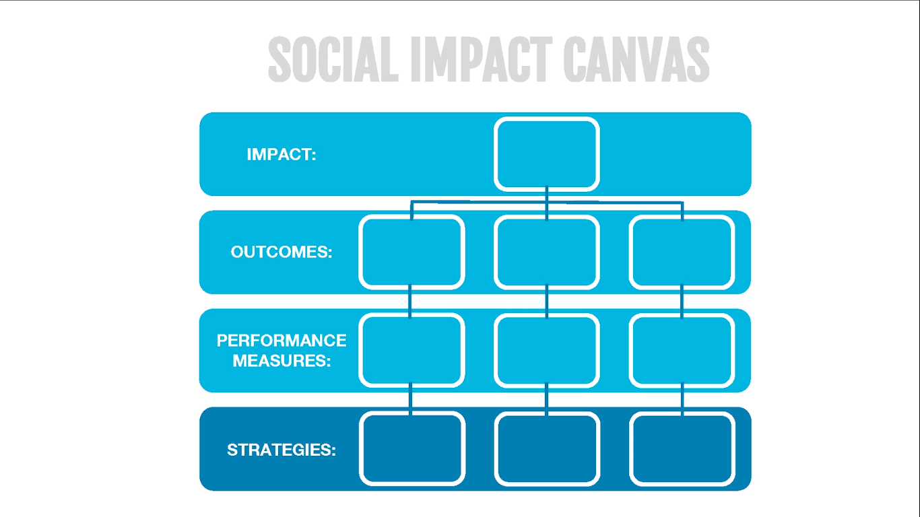
Source: Social Ent Institute

Slide 36
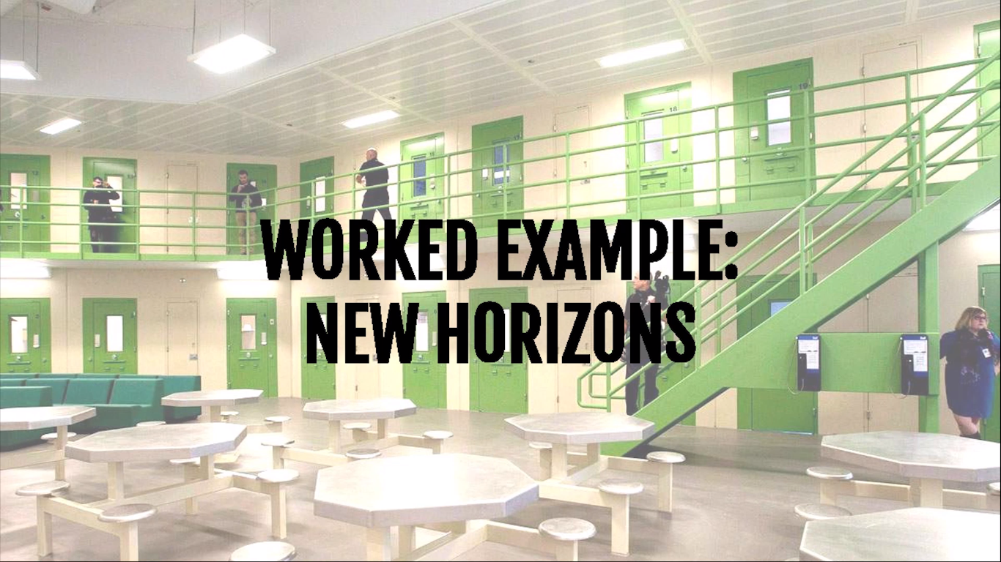
Source: Social Ent Institute
Notes:
New horizons provide support to people moving back into the community after time in prison.

Slide 37
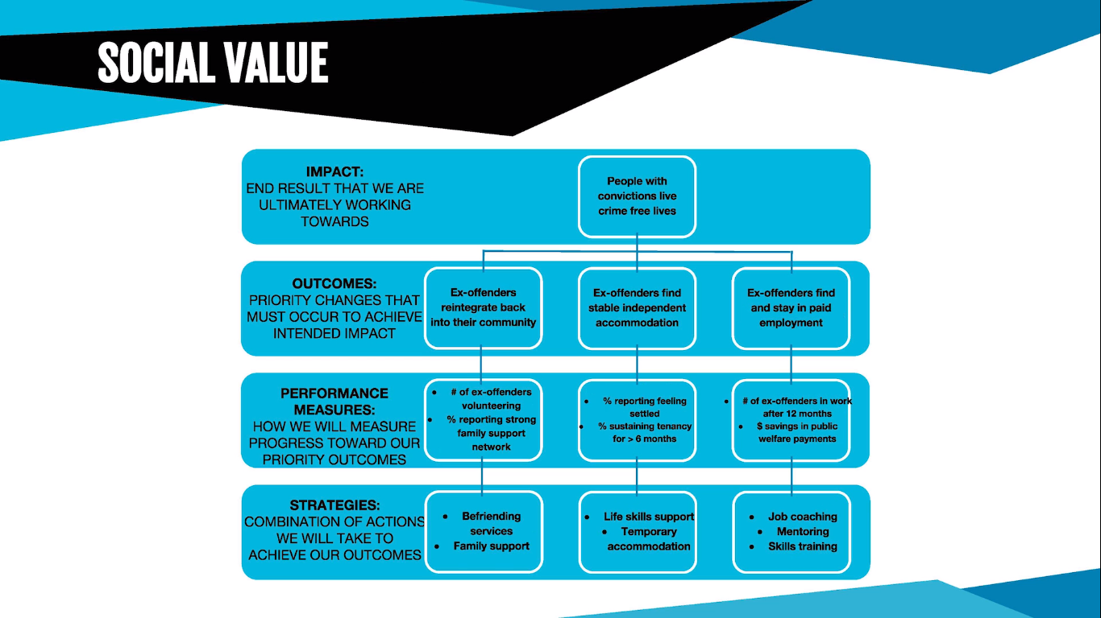
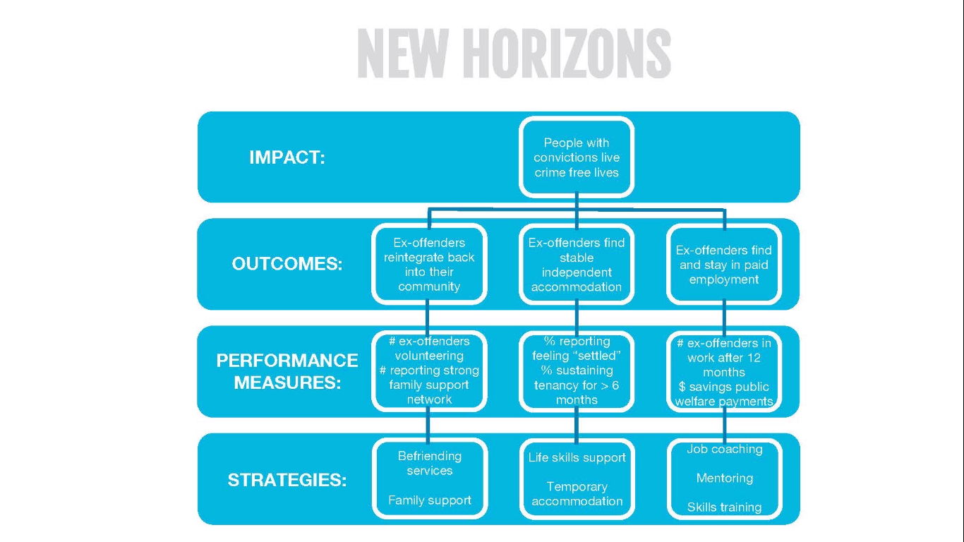
Source: Social Ent Institute
Notes:
New Horizions – provides traditional support to people moving back into the community after time in prison.
In order to achieve its ultimate goal of reducing rates of re-offending its outcomes focused on achieving stable accommodation, sustained employment and a strong local support network for ex-offenders
Its really important to prioritise the main changes that will have the most effect on your intended impact. For new horizons they chose these three outcomes as having the most impact. This is what we call the results formula where you can achieve the intended impact by the combined contribution of these three outcomes.
The performance measures help determine measures that tell us if we are successfully contributing to these outcomes. For new horizions this was counting the number of ex offenders who were volunteering, and counting the number who were showing strong family supports. They also wanted to measure the % reporting feeling settled in a home environment, and the % that were sustaining tenancy for greater than 6 months. And finally they wanted to measure the number of ex offenders in work after 12 months and how that saved public welfare programmes in terms of a monetary value.
New horizion has a number of programmes and activities to help ex-offenders get back on track. First they offer befriending services trying to help ex-offenders get greater social ties or connections, and encouraging family support. They also provide life skills training and coaching and temporary accommodation as they get back on their feet. Finally they provide job coaching, mentoring and skills training that’s focused on helping ex-offenders get employment.
Good range of measures used that is carefully considered to gauge achievement of the relevant outcome. There are also a mix of indicators and metrics used. The indicators look good as they aim to measure the longer term effects.
So on one page, you can see what they are trying to achieve both in the short and long term and how they get there with their different programmes and services.

Slide 38

Source: Social Ent Institute
Notes:
Finally, think about showing this canvas to people who are experienced in your sector. Ask for feedback and references to other sources of information and direction on where you need to go. It will help you form a better representation on what you are trying to change in the world.
Get as much feedback as you can as it will give you insights to help you move forward and grow
Complete your worksheet with the strategies and activities that you will undertake to make that ultimate impact.

